Slide 1
Mini-Project II
Database of POI from Yelp and Foursquare
Week 2

Slide 2


Mini-Project
Build the database of Points of Interest in the area
Find out which API has better coverage in the selected area.
Better coverage
Ten 10 POI based on Popularity

Slide 3




Tools
Data analysis
Libraries:
Requests
Pandas
Sqlite3
foursquare
from IPython.display import JSON
Draw.io:
ERD Diagram
Build database
Analyze output

Slide 4
Data Source
API
Search for Venues: https://api.yelp.com/v3/businesses/search
Venue details: https://api.yelp.com/v3/businesses/{id}
API
Search for Venues: https://api.foursquare.com/v2/venues/search
Venue details: https://api.foursquare.com/v2/venues/VENUE_ID

Slide 5
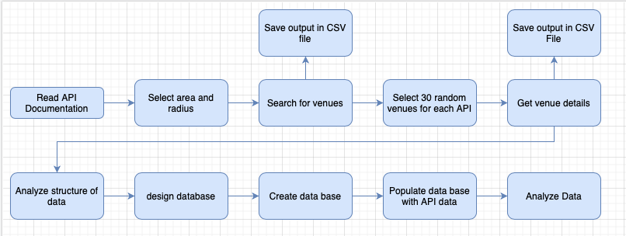
Process
Data is different it both applications, load it to data base require more time
API calls limitation
API limit of up to 50 venues

Slide 6
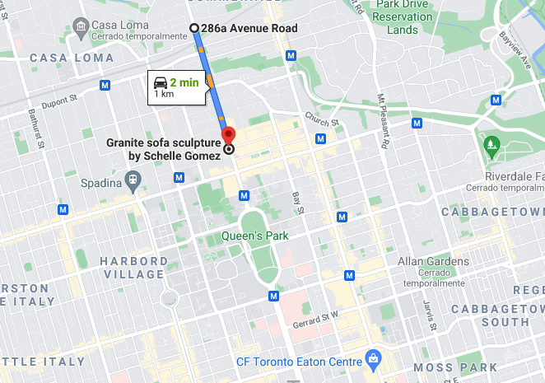
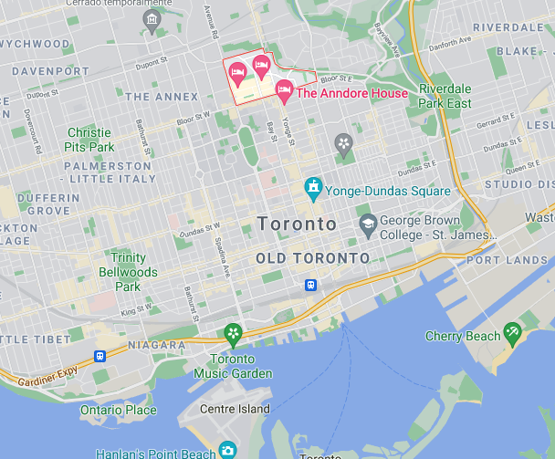
Data
Area: Toronto Yorkville (latitude: 43.6702287372475, long: -79.39126856350059)
Radius: 1km
APIs
Foursquare
Yelp
Points of Interest categories:
Museums
Soup restaurants
Coffee shops
Music Venues
Sample of 30 venues due to limited access to Foursquare API

Slide 7
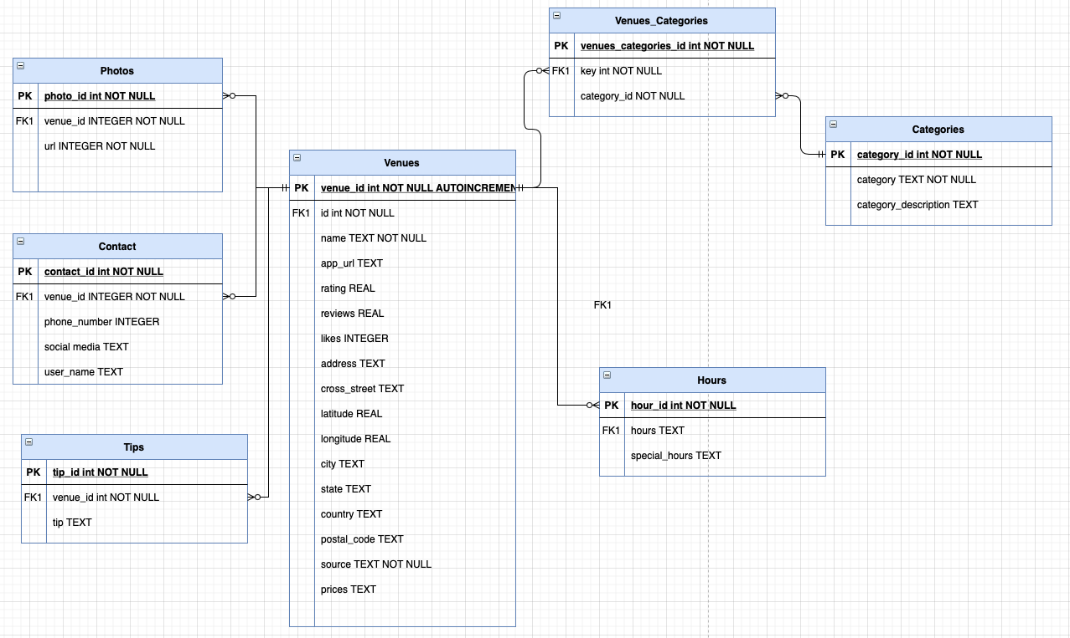
ERD – Points of Interest database

Slide 8


Yelp vs Foursquare
Total venues from API:
49
86

Slide 9
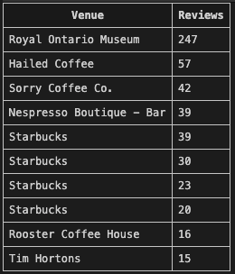
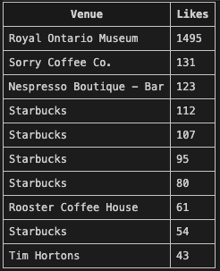
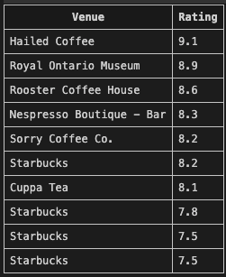
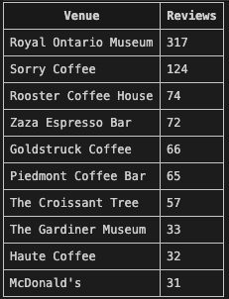
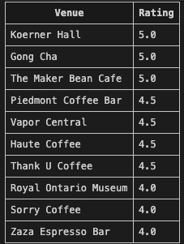
Top 10 - Popular

Slide 10
Challenges
Information
Database
Popularity
Coverage

Slide 11
Recommendations

Slide 12
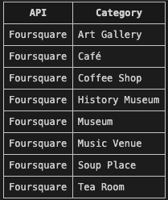
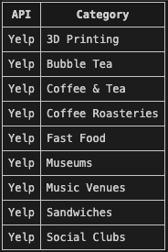
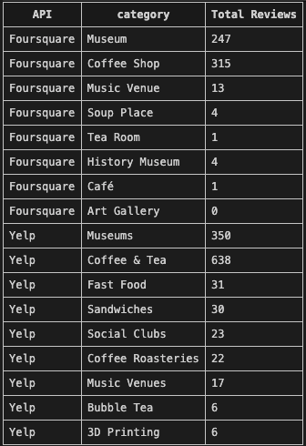
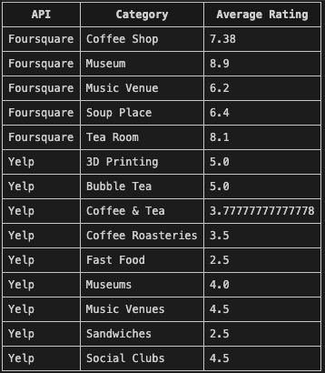
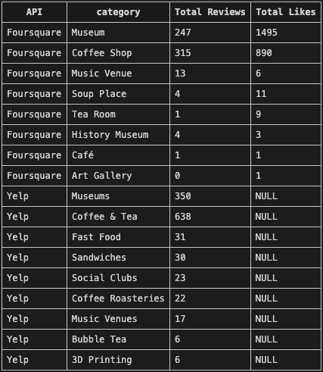
More tables

